Slide 1
OpenSCENARIO Generation
Share: Lingtong Zhang

Slide 2
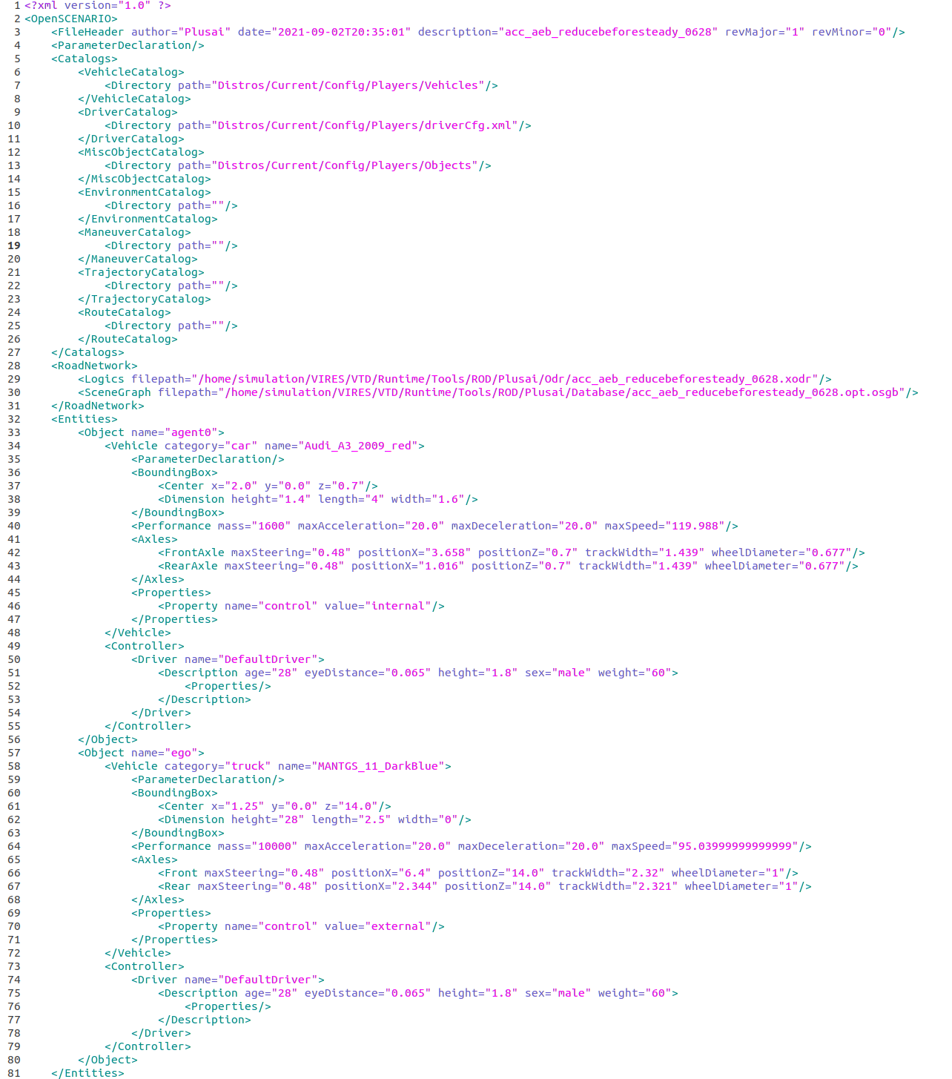
Structure
Items | Instructions
Catalogs | Path of Model References
RoadNetworks | Path of .xodr, .osgb File
Entities | Declaration of object parameters

Slide 3
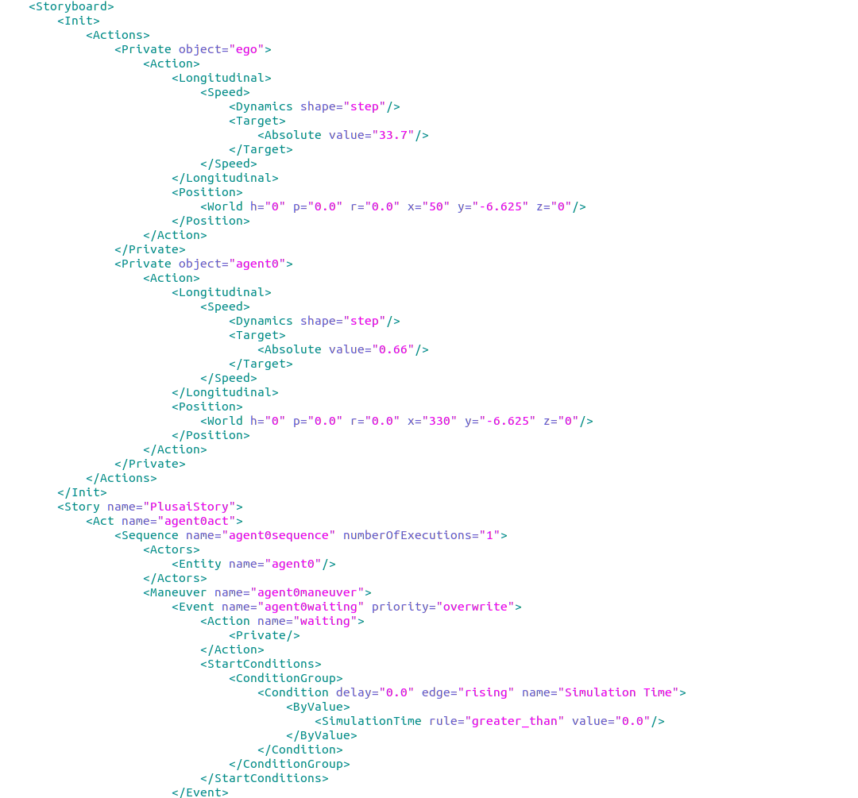
Structure
Items | Instructions
Storyboard | Initialization and Maneuver Definition
Init | Actions- longitudinal(speed, offset), lateral action(offset) Position- World Absolute position
Story | Vehicle Maneuvers Parallized executation(by trigger)
Sequence | Series of Maneuvers at the beginning , specify the owner object then defines the Maneuvers
Maneuver | Series of Events

Slide 4
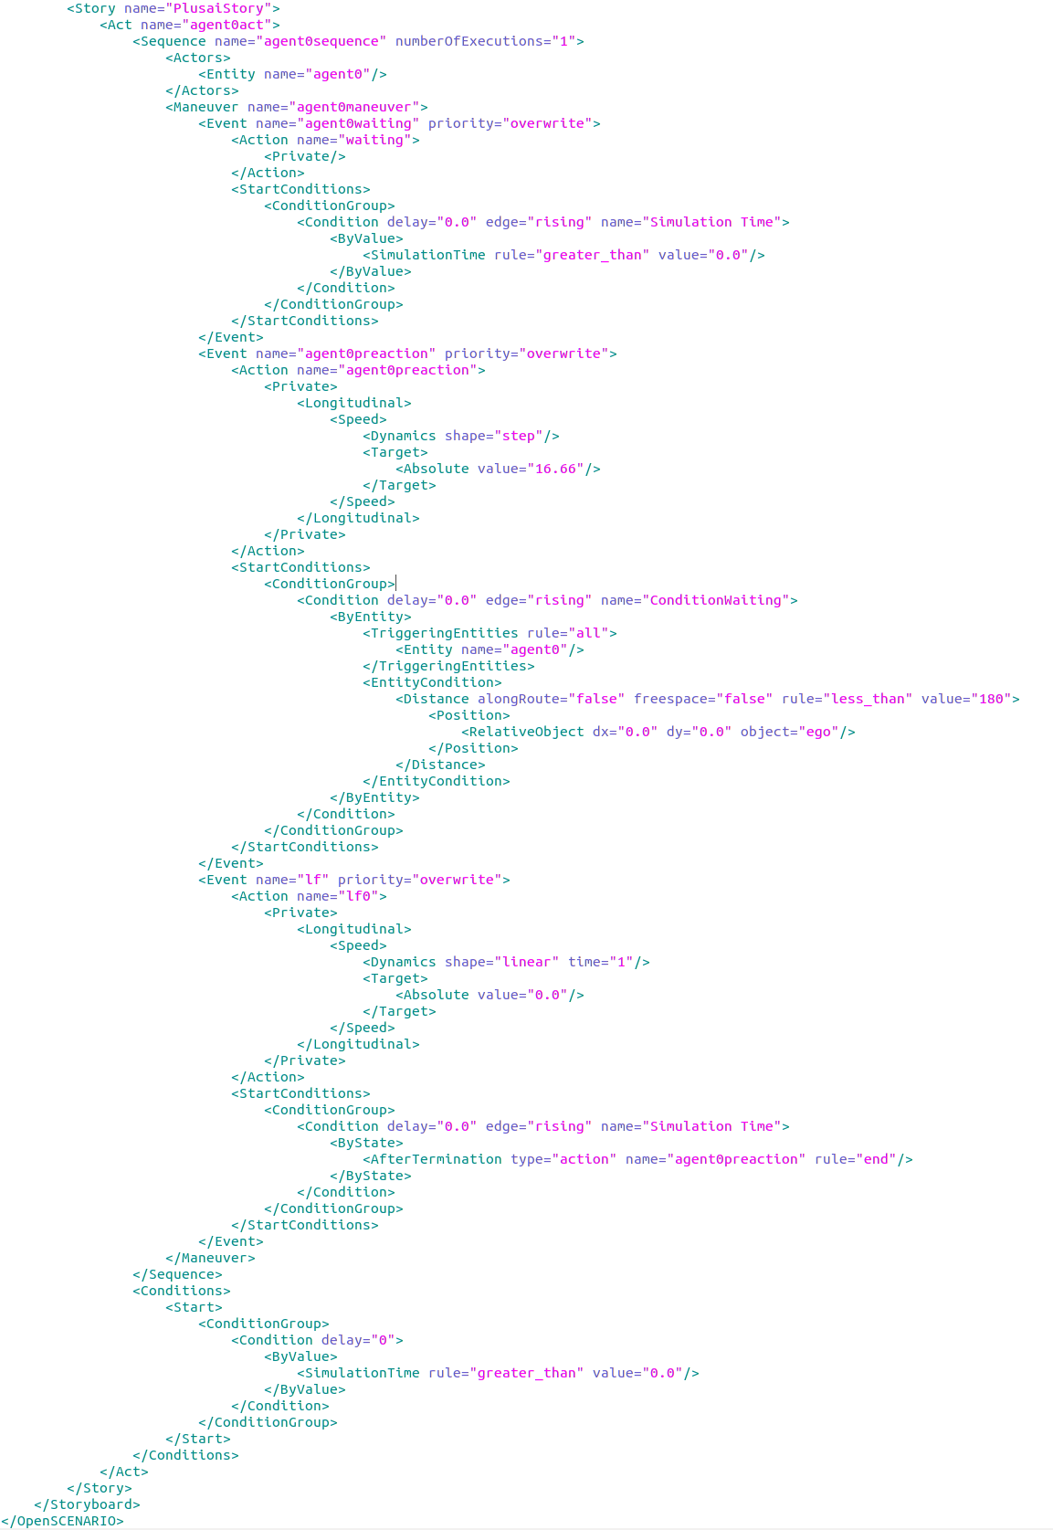
Structure
Items | Instructions
Event | Action- Longitudinal and Lateral Actions StartCondition- Event Trigger
Story | Vehicle Maneuvers Parallized executation(by trigger)
SequenceCondition | Condition- Sequence Trigger

Slide 5
Problems
部分trigger没有来的及做有效性验证, ByState<AfterTermination>
目前只支持绝对时间trigger以及相对距离的trigger
在做场景验证时，车辆无法获得道路高程信息
目前自动化工具仅提供OSC文件0.9X版本的模板

